Slide 1
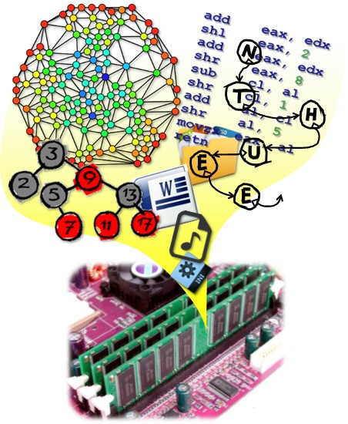
Data Structures
CH8 Hashing
Prof. Tai-Lang Jong
Office: Delta 928
Tel: 42577
email: tljong@mx.nthu.edu.tw
Spring 2021

Slide 2
Outline
8.1 Introduction
8.2 Static hashing
8.3 Dynamic hashing
8.4 Bloom filters

Slide 3
Hashing(雜湊) in Data Structures
Searching is dominant operation on any data structure. Most of the cases for inserting, deleting, updating, all operations required searching first. So searching operation of particular data structure determines it’s time complexity.
If we take any data structure, the best time complexity for searching is O(log n) in AVL tree and sorted array only. Most of the cases it will take O(n) time.
To solve this searching problem hashing concept is introduced which will take O(1) time for searching. It’s constant time.

Slide 4
Dictionary ADT Revisited
A dictionary is a collection of items.
Each item is a pair
(key, element) or (key, value)
Pairs have different keys.
Keys may not have an ordering
Dictionary represents a mapping from keys to elements.
The primary use of dictionary is to store elements so that they can be located quickly using (search) keys
Operations.
Get(theKey) => search
Delete(theKey) => delete
Insert(theKey, theElement) => insert
Additional operations: (for dynamic dictionary)
Ascend() (sorting)
Get(index)
Delete(index)

Slide 5
ADT 5.3 Dictionary Revisited
template <class K, class E>
class Dictionary {
public:
virtual bool IsEmpty() const = 0;
// return true iff the dictionary is empty
virtual pair <K, E>* Get(const K&) const = 0;
// return pointer to the pair with specified key; return 0 if no such pair
virtual void Insert(const pair <K, E>&) = 0;
// insert the given pair; if key is a duplicate update associated element
virtual void Delete(const K&) = 0;
// delete the pair with specified key
};
The dictionary ADT provides operations for storing records, finding records, and removing records from the collection.
This ADT gives us a standard basis for comparing various data structures.

Slide 6
Applications of Dictionary
Spelling checker
Thesaurus
Natural language dictionary
key: word in language X; value: word in language Y
Index for a database
Contact book
key: name of person; value: telephone number
Property-value collection
key: property name; value: associated value
Symbol tables generated by loaders, assemblers, and compilers, e.g.,
Table of program variable identifiers
key: identifier; value: address in memory

Slide 7
Representation of Dictionary
Sorted or Unsorted sequences (linear lists)
Easy to implement, Space efficient
Insertion itself is fast, but needs lookup to check if the name was already in
Lookup is slow
Binary search tree
Get, Insert, Delete take O(n) time (WC)
Balanced binary search tree
Get, Insert, Delete take O(logn) time
Hashing
Get, Insert, Delete take O(1) time
AVL trees
self-organizing BST
red-black trees
(a,b)-trees (in particular: 2-3-trees)
B-trees

Slide 8
Simple Implementations of Dictionary
Elements of a dictionary can be kept in a sequence (linked list or array):
data size: number of elements (n);
dominant operation: key comparison
Unordered:
search: O(n); insert: O(1)(no checking); delete: O(n)
Ordered array:
search: O(logn); insert O(n); delete O(n)
Ordered linked list:
search: O(n); insert O(n); delete: O(n)
(keeping the sequence sorted does not help in this case!)
Space complexity: Θ(n)

Slide 9
Complexity Of Dictionary Operations Get(), Insert() and Delete()
n is number of elements in dictionary

Slide 10
Symbol Table
Symbol Table
Can be viewed as a set of name-attribute pairs (like (key, element) or (key, value) pair in dictionary)
A form of dictionary
Is used widely in many applications include spelling checker, thesaurus, loaders, compilers
Common operations on a symbol table
Search a particular name in the table (Get(K&))
Retrieve the attributes of that name
Modify the attributes of that name
Insert a new name and its attributes (Insert(<K,E>&))
Delete a name and its attributes (Delete(<K,E>&))

Slide 11
How To Implement Symbol Table?
Direct Addressing
Assume potential keys are numbers from some universe U ⊆ N.
An element with key k ∈ U can be kept under index k in a |U|-element array:
search: O(1); insert: O(1); delete: O(1)
This is extremely fast! What is the price?
n - number of elements currently kept.
What is space complexity?
space complexity: O(|U|) (|U| can be very high, even if we keep a small number of elements!)
Direct addressing is fast but waists a lot of memory (when |U| >> n)

Slide 12
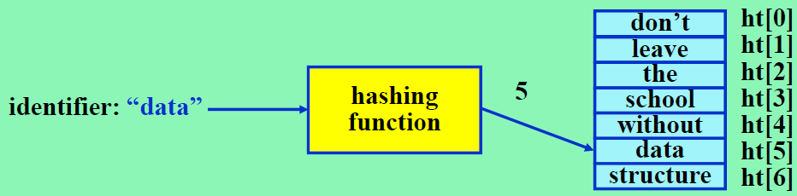
How To Implement Symbol Table?
Binary Search Tree
Allows efficient search, insert, and delete operation in O(h), where h is the height of the tree
Worst case O(n), where n is the total number of identifiers
Can be improved to O(log n) (balanced BST, AVL tree, ..)
Hash Table
A fixed-size linear array, ht
For an identifier, x, The address of x is determined by a hashing function h(x)

Slide 13
Hash Tables
A hash table is another easy and efficient implementation of a symbol table.
Elements are kept in an b-element table, b << |U|
It works with keys that are not ordered, but supports only
Insert
delete
search
It is based on the concept of a hash function h(key).
Maps each possible element into a specified bucket
The number of buckets b is much less than the number of possible elements |U| (b << |U|)
Each bucket can store a limited number of elements
hashing function: h : U → [0..b − 1]

Slide 14
Hashing Non-integer Keys
For integer key:
hashing function: h : U → [0..b − 1], (|U| > b)
What if the type of key is not integer?
Additional step is needed:
Before computing the hash function, the key should be transformed to integer.
For example: key is a string of characters, the transformation should depend on all characters.
This transforming function should have similar properties to hashing function.

Slide 15


Registration Division Example
請大家向註冊組承辦人 查詢學期成績
全校多數都打電話、寄email給第一位
承辦人 | 分機 / Email
陳OO | 31300 / chen@nthu...
郭OO | 31301 / kuo@nthu...
李OO | 31302 / li@nthu...
林OO | 31303 / lin@nthu..
王OO | 31304 / wang@nthu...

Slide 16
Hash Concepts
Hash function
Any deterministic function that can map data of arbitrary size (original keys) to a continuous range data of a desired fixed size: 0≤h(k)<b (hashed keys)
Hash Function
Keys
(e.g., names)
Hashed Keys (e.g., 0~4)
Values
承辦人 | 分機
陳OO | 31300
郭OO | 31301
李OO | 31302
林OO | 31303
王OO | 31304
h()
0
"周杰倫"
2
1
"Donald Trump"
3
2
3
"鈴木一朗"
0
4
… …

Slide 17
Hash Concepts
Hash function
It shuffles the order of mapping
But it is deterministic
Hash Function
Keys
(e.g., names)
Hashed Keys (e.g., 0~4)
Values
承辦人 | 分機
陳OO | 31300
郭OO | 31301
李OO | 31302
林OO | 31303
王OO | 31304
h()
0
"周杰倫"
2
1
"Donald Trump"
3
2
3
"鈴木一朗"
0
4
… …

Slide 18


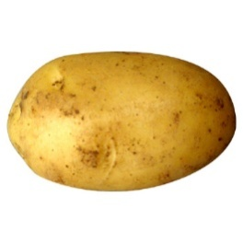
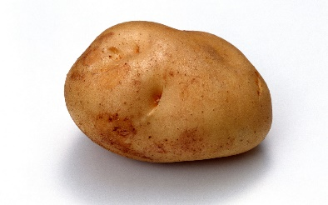
Hash in Cooking
Hash: "chop and mix foods"
Example: hash browns (薯餅)
McDonald
Function

Slide 19



Hash in Chinese Decomposition
Decompose Chinese characters into keyboard strokes
Facilitate Chinese input
Example: the Boshiamy (嘸蝦米) decomposition scheme
Boshiamy
Function
哈
O
OAO
O
州
YYY
哥
o
o
TOTO

Slide 20

Hash in Storing Data
Example: Storing students' grades according to their name initial letters
Name
initial
A
(Alice, 100)
(John, 95) | (Jane, 100)
95
J
B
John
…
100
I
Alice
A
J
100
K
Jane
…
J
Z

Slide 21
Hashing
Static hashing
Store the dictionary (key, element) pairs in hash table
Hash Table
Hash Function
Collision & Overflow Handling
Open addressing or open hashing
Chaining
Dynamic hashing (extendible hashing)
Retain the fast retrieval time of conventional hashing while extending the technique so that it can accommodate dynamically increasing and decreasing table size without penalty.
Provide acceptable hash table performance on a per operation basis using directory and directoryless

Slide 22
Outline
8.1 Introduction
8.2 Static hashing
8.3 Dynamic hashing
8.4 Bloom filters

Slide 23
Advantages of Hashing
Hash table
(Bob, 80) | (Ben, 70)
(Irene, 85)
(John, 95) | (Jane, 100)
(Ken, 75)
(Zoe, 80)
Hash function
h(key)
Identifier (key)
Inserting, deleting, and searching can be ~O(1) time
Hash function computation is designed in O(1)
Indexing the corresponding bucket in the table is O(1)
Searching all slots in a bucket for a key is also O(1)
The number of slots is independent of the number of pairs stored in the table

Slide 24
Terminology in Hashing
Buckets & Slots
b buckets in ht
h(k) is the home bucket of a key k
s slots per bucket
Identifier density = n/T
T possible different keys (|U|)
n stored pairs in ht
Loading factor (density) = α = n/(sb)
b is the number of buckets, s is the number of slots per bucket
Synonyms (collision)
Two identifiers, I₁ and I₂ are synonyms if h(I₁) = h(I₂)
A pair with a key k is stored in a hash table ht
Slots
0
(Alice, 100)
(Bob, 80) | (Ben, 70)
(Irene, 85)
(John, 95) | (Jane, 100)
(Ken, 75)
(Zoe, 80)
1
…
Buckets
…
b-1

Slide 25
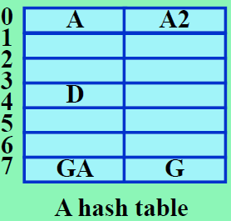
Collision and Overflow
Collision
When two nonidentical identifiers are hashed into the same bucket
Overflow
When a new identifier is mapped or hashed by h into a full bucket
Collision exists at location 0 and 7
Overflow will occur when AA is hashed into the table (h(AA) = 0)!

Slide 26
Efficiency of Hash Table
Search or insertion time of a hash table
(1) compute the hash function
(2) search a bucket
The above times are independent of n – O(1)
Collision is inevitable
Taking the first character is not a good hashing because of too much collision
many variables in a program begin with the same character
An overflow mechanism is necessary

Slide 27
Hash Function
定義域
通常為不限大小
值域 通常為有限大小[0,b)
Hash Function
通常必須"多對一"
絕不會"一對多"

Slide 28
Hash Function
Good hash functions reduce the chance of collisions
Enlarging hash table size can also reduce collisions
At the cost of memory size
Ideal hash functions have
Minimal number of collisions
Uniform distribution of keys for various values
Easy (fast) to compute
Maximum usage of the information present in the values (keys)
Yield different values even for very similar keys
Slots
h(A)=0
(Alice, 100)
(Bob, 80) | (Ben, 70)
(Irene, 85)
(John, 95) | (Jane, 100)
(Ken, 75)
(Zoe, 80)
h(B)=1
…
h(I)=9
Buckets
h(J)=10
h(K)=11
…
h(Z)=25

Slide 29
Uniform Hash Function
Basic desired properties of hash function
Easy to compute
Minimize the number of collisions
Uniform hash function
A good hash function
Should also depend on every character of an input identifier
Uniform hash function
Let x be an identifier chosen at random
Then, the probability that h(x) = i is 1/b for every bucket i
That is, the hash function does not result in a biased use of the hash table for random inputs

Slide 30
Hash Functions
Classical examples
Modulo (division)
Mid-square
Folding
Digit analysis
String-to-integer conversion
We can design our own hash functions

Slide 31
Hash Function: Modulo (Division)
Most widely used hash function in practice
Procedure
h(k) = k % D
Selection of D
D is the number of buckets
D would better be an odd number
Even divisor D always maps even keys to even buckets and odd keys to odd buckets
Real-world data tend to have a bias toward either odd or even keys
It would be even desirable if D can be a prime number or a number having no prime factors smaller than 20

Slide 32
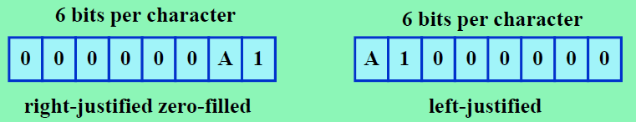
Hash Function: Modulo (Division)
hash function h_{D} (k) = k % D
where % is the modulo operator
That is, the remainder is used as the hash address
Hash address
in the range from 0 through ( D-1) ⇒ implies that table size is D
D should not be a power of 2
otherwise, h_{D}(k) may depend only on the least significant bits of x
e.g., D=2³, then A1 ⇒ encoded to 2⁶(10) + 1 ⇒ h_{D}(A1) = 1
XY1 ⇒ encoded to 2¹²(33) + 2⁶(34) + 1 ⇒ h_{D}(XY1) = 1
D is usually a prime number

Slide 33
Hash Function: Mid-Square
h(k) = some middle r bits of the square of k
The number of bucket is equal to 2^{r}
Example
k | k² |  | h(k)
0 | 0 | 0000 0000 | 0
1 | 1 | 0000 0001 | 0
2 | 4 | 0000 0100 | 1
3 | 9 | 0000 1001 | 2
4 | 16 | 0001 0000 | 4
5 | 25 | 0001 1001 | 6
6 | 36 | 0010 0100 | 9
7 | 49 | 0011 0001 | 12
k | k² |  | h(k)
8 | 64 | 0100 0000 | 0
9 | 81 | 0101 0001 | 4
10 | 100 | 0110 0100 | 9
11 | 121 | 0111 1001 | 14
12 | 144 | 1001 0000 | 4
13 | 169 | 1010 1001 | 10
14 | 196 | 1100 0100 | 1
15 | 225 | 1110 0001 | 8

Slide 34
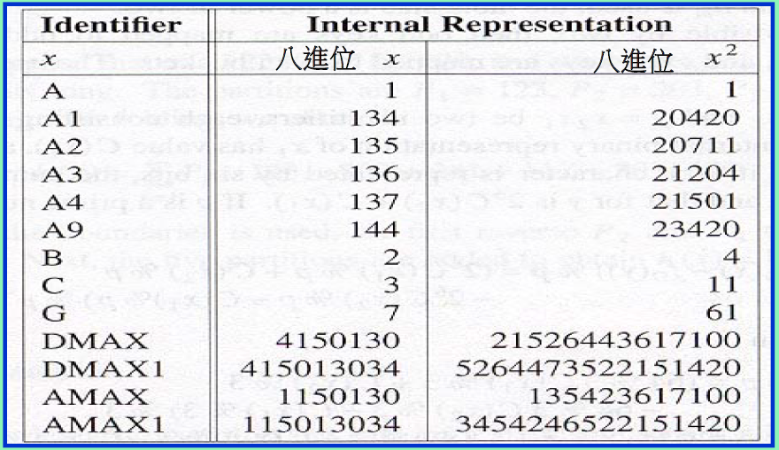
Hash Function: Mid-Square
A – 1 = 1₈
B – 2 = 2₈
.
.
.
Z – 26
0 – 27 = 33₈
1 -- 28 = 34₈
2 – 29 = 35₈
..
9 -- 36 = 44₈
The coding of identifier x is right-justified, zero-filled, and has six bits per character
Table size will be a power of 2

Slide 35
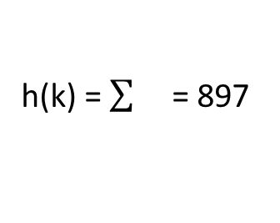
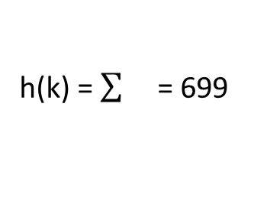
Hash Function: Folding
Partition the key into several parts and add them together
Two strategies: shift folding and folding at the boundary
Example
k = 12320324111220 =
Shift folding
Folding at the boundary
123 | 203 | 241 | 112 | 20
123
h(k) = = 699
123 | 203 | 241 | 112 | 20
20
h(k) = = 897
123 | 302 | 241 | 211 | 20
20

Slide 36
Hash Function: Digit Analysis
Application
when all the identifiers are known in advance
Procedure
Step 1: Each identifier is interpreted as a number using radix r
Step 2: Analyze the distribution of each digit
Step 3: Drop biased digits
The digits with the most skewed distributions are deleted one by one until the remaining digits is small enough to give an address
Example
Given three identifiers in radix-9 form: 891, 792, 793
Digit distribution: 1st {8, 7, 7}, 2nd {9, 9, 9}, 3rd {1, 2, 3}
The most skewed digits: the 2nd

Slide 37
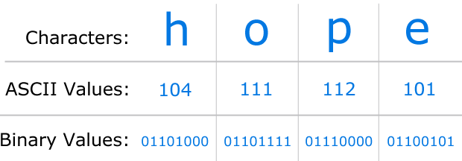
String-to-Integer Conversion
Useful when keys are strings
Procedure
Treat every n character as an 8n-bit integer
ASCII represents a character using 8 bits
Add all integers together to obtain the overall value
Adopt the aforementioned hash functions (modulo, folding…)

Slide 38
Converting a String to an Integer
unsigned int StringToInt(string s)
{// 根據s的所有字元，把s轉換成一個非負的int
int length = (int) s.length(); // s裡的字元個數
unsigned int answer = 0;
if (lengh % 2 == 1){// 長度為奇數
answer = s.at(length - 1);
length--;
}
// 長度現在為偶數
for (int i = 0; i < length; i += 2){// 一次做兩個字元
answer += s.at(i);
answer += ((int) s.at(i + 1)) << 8;
}
return answer;
}

Slide 39
C++ STL template class hash<T>
C++ STL provides specializations of the STL template class hash<T> that transform instances of type T into a nonnegative integer of type size_t.
template<>
class hash<string> {
public:
size_t operator()(const string theKey) const
{ // Convert theKey to a nonnegative integer
unsigned long hashValue = 0;
int length = (int) theKey.lenght();
for (int i = 0; i < length ; i++)
hashValue = 5 * hashValue + theKey.at(i);
return size_t(hashValue);
}
};

Slide 40
Design Our Own Hash
Recall that
Hash function is any deterministic function that can map data of arbitrary size (original keys) to data of a desired fixed size (hashed keys)
So of course we can design a hash like this
Consideration:
We need to argue the advantages of our hash compared with the commonly used ones
Original Keys
Folding
+ Trump's Birthday
Mid-Square
Modulo
Hashed Keys

Slide 41
Secure Hash Functions
Example
SHA-1
SHA256
MD5
Usage
Message authentication
Password store (能驗證密碼但又可防範洩漏密碼)
Digital signature (防止變造)
Digital currency
…

Slide 42
Message Authentication
A message M to be transmitted over an insecure channel from A to B.
Assume we have a means to transmit messages much smaller than M securely, e.g., encrypt smaller message or transmit the smaller message on a more expensive but far more secure channel.
Send h(M) using more secure method. Send M over insecure channel.
At B, received M’ and h(M); compute h(M’) and compare with h(M) to decide if received M’ is correct.
It should be difficult for a malicious user who has knowledge of h & M to determine a synonym of M --weak collision resistance property

Slide 43
Secure Hash Function Properties
Desired secure hash function properties:
Weak collision resistance:
It is difficult for a malicious user who has knowledge of h & M to determine a synonym of M
One-way property:
For a given c, it is computationally difficult to find a k such that h(k) = c (inverse hashing problem)
Strong collision resistance:
It is computationally difficult to find a pair (x,y) such that h(x) = h(y)
Several cryptographic hash functions with these properties have been developed. They also have additional properties:
h can be applied to a block of data of any size
h produces a fixed-length hash code
h(k) is relatively easy to compute for any given k

Slide 44
Secure Hash Algorithm (SHA)
Developed at the National Institute of Standards & Technology (NIST) in USA.
SHA-1 function:
Input: any message length < 2⁶⁴ bits
Output: a 160-bit code
Step 1: Preprocess the message so that its length is q*512 bits for some integer q. The preprocessing may entail adding a string of zeros to the end of the message.
Step 2: Initialize the 160-bit output buffer OB, which comprises five 32-bit registers A, B, C, D, and E, with A = 0x67452301, B = 0xefcdab89, C = 0x98badcfe, D = 0x10325476, E = 0xc3d2e1f0.
Step 3: for (int i = 1; i <= q; i++) { Let B_{i} = ith block of 512 bits of the message; OB = F (OB, B_{i}); //function F consists of 4 rounds of 20 atomic steps
}
Step 4: Output OB。

Slide 45
Atomic SHA Operation
t | = | Step number, 0≤t≤79
f_{t}(B,C,D) | = | Primitive (bitwise) logical function for step t; e.g., (BΛC)V(BΛD)
S^{k} | = | Circular left shift of the 32-bit register by k bits
W_{t} | = | A 32-bit value derived from B_{i}
K_{t} | = | A constant

Slide 46
Security Hash: MD5 Example
0x67452301
0xEFCDAB89
0x98BADCFE
0x10325476
Input (32 bit at a time)
F(X, Y, Z)
Sin table
+
rotate
+
Output Hash

Slide 47
Security Hash: MD5 Example
https://www.md5hashgenerator.com/
Example
“NTHU” → 8191af722cfd2890b7a9e986003a6439
“NTHU1” → 4c97870289739e75576a4cbeb6222e25
“資料結構” → 9aa8415c41bb436d4b6e5618a7be6360
Deterministic results
Everyone can get exactly the same results, although the results look like random numbers

Slide 48
Security Hash: MD5 Example
Important properties
Hard to find the inverse
“祝大家期末考順利!" → 21cee26fd407729a1c740105891e3fca
Easy to verify
Hard to find another meaningful input that has the same hash (synonyms)
?

Slide 49




Usage: Password Store
username: password
username: password
Mary: abcabc
John: edp903d
Bob: HE3dpq7

Slide 50
Usage: Password Store
Login
username: hashed_password
Mary: 5abb7fa…
John: 8e2c1f8…
Bob: ed6e5ad…
?
???

Slide 51
Usage: Digital Signature
有奬徵答，請大家解一題資結問題，前3快解出問題的給獎品!
狀況一
有人搶先說“我解開了”再慢慢解題，難以判斷真實順序
狀況二
第一名公布了答案，二三名都說“我也是這麼想的”
狀況三
大家統一把答案交給某個裁判再檢查是誰最快回答出正確答案。但裁判的公平性無法驗證。
Security hash可以幫忙解決這個問題

Slide 52
Usage: Digital Currency
數位貨幣(例如比特幣)
去中心化
由貨幣使用者記帳，而非由政府或銀行記帳
記帳的使用者會得到一些報酬
問題
怎麼決定記帳權歸屬，且不會被特定使用者把持?
怎麼避免帳本被竄改?

Slide 53
Usage: Digital Currency
方法
要求所有使用者一起解inverse hash問題
請把x取代成數字，使“A轉給B十元(xxxxxxxx)”這個字串的MD5前 N 碼是0
A轉給B十元(00000000) → 4299bf747…
A轉給B十元(00000001) → 2c81a694d…
A轉給B十元(00000002) → 551741357…
求解動作稱挖礦，困難度被控制在約10分鐘才能解答一次。
挖礦有利可圖，因此很多人參與
想要單方把持記帳權，必須投入非常多電腦，不敷成本
後帳本與前帳本相關(區塊鏈)
想從竄改已經成形的帳本，必須投入非常多電腦在短時間內重算竄改位置之後的inverse hash問題，不敷成本

Slide 54
Overflow Handling
Problem
When a new identifier is hashed into a full bucket, then we need to find another open bucket
Methods
Open addressing -- find the closest bucket that is not full
Linear probing
Quadratic probing
Rehashing
Chaining
Implement each bucket as a linked list

Slide 55
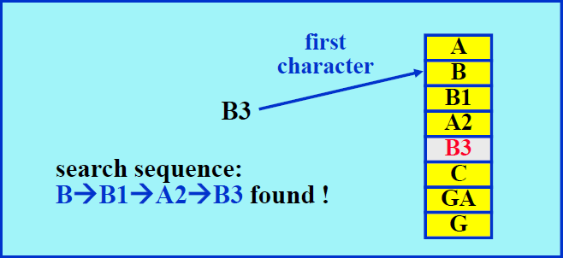
Linear Open Addressing
Procedure of searching an identifier x
Step 1: compute h(x)
Step 2: examine identifiers at positions ht[h(x)], ht[h(x)+1], ..., ht[(h(x)+j] in this order until one of the following happens:
(a) ht[ h(x)+j ] = x; in this case x is found
(b) ht[ h(x)+j ] is null; x is not in the table
(c) We return to the starting position h(x); the table is full and x is not in the table

Slide 56
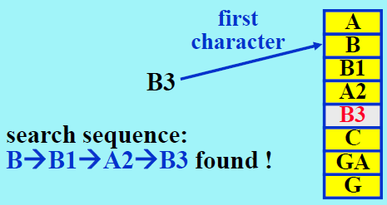
Program 8.4 Linear Probing
template < class K, class E >
pair< K, E>* LinearProbing <K, E>::Get(const K& k)
{ // search the linear probing hash table ht（each bucket has exactly one
// slot）for k. If a pair with this key is found, return a pointer to this pair;
// otherwise, return 0
int i = h(k); // home bucket
int j;
for ( j = i ; ht[j] && ht[j]→first != k;) {
j = (j + 1 ) % b; // treat the table as circular
if ( j == i ) return 0;// back to the start point
}
if(ht[j]→first == k) return ht[j];
return 0;
}

Slide 57
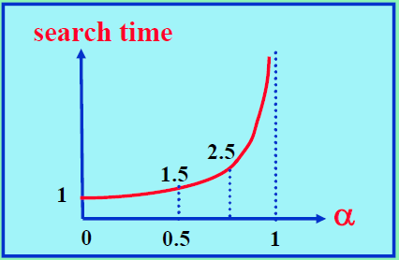
Problem of Linear Open Addressing
Identifiers tend to cluster together
Increase the search time
Could be worse than the search tree structure
An analysis shows that
It takes (2-α)/(2-2α) to look up an identifier
Where α is the loading density (n/(sb))
Quadratic probing
improve the clustering problem
check sequence:
((h(k)+i²)%b) and ((h(k)-i²)%b)
i = 1, 2, ...

Slide 58
Rehashing
Another way to control the growth of clusters is to use a series of hash functions h₁, h₂, …, h_{m}. This is called rehashing.
Buckets h_{i}(k), 1 ≤ i ≤ m are examined in that order.
Double hashing:
If h(k) is occupied, then we iteratively try buckets
h(k) + j*h‘(k) for j=1, 2, …

Slide 59
Chaining
Linear probing performs poorly because the search for an identifier involves comparisons with identifiers that have different hash values.
e.g., search of ZA involves comparisons with the buckets ht[0] – ht[7] which are not possible of colliding with ZA.
Unnecessary comparisons can be avoided if all the synonyms are put in the same list, where one list per bucket.
Each chain has a head node. Head nodes are stored sequentially.

Slide 60
Chain-Based Hash Table
Each bucket is a chain
Chain nodes are typically unordered
We typically expect the hash function spreads records uniformly enough
Thus each chain does not contain too many nodes
Linearly traversing a chain is required for inserting, finding, and removing a key
data
link
A
0
(Alice, 100)
0
B
(Bob, 80)
(Ben, 70)
0
…
I
(Irene, 85)
0
J
(John, 95)
(Jane, 100)
0
K
(Ken, 75)
(Kevin, 70)
0
L
(Linda, 90)
0
M
(Mary, 85)
0
…
(Zoe, 80)
0

Slide 61
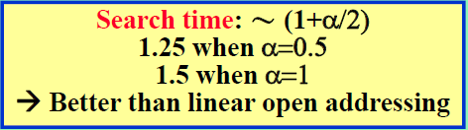
Chaining

Slide 62
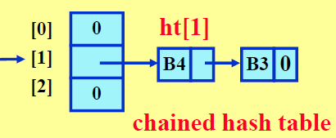
Program 8.5 Chain Search
template <class K, class E>
pair<K, E>* Chaining <K, E>::Get(const K& k)
{// 在鏈雜湊表ht中搜尋k，如果找到具有這個鍵值的字典對，
// 那麼回傳這個字典對的指標；否則回傳0
int i = h(k); // 主桶
// 搜尋鏈ht[i]
for(ChainNode<pair<K,E>>* current = ht[i]; current;
current = current ->link)
if(current->data.first==k)return &current->data;
return 0;
}
i = h(“B3”) = 1

Slide 63
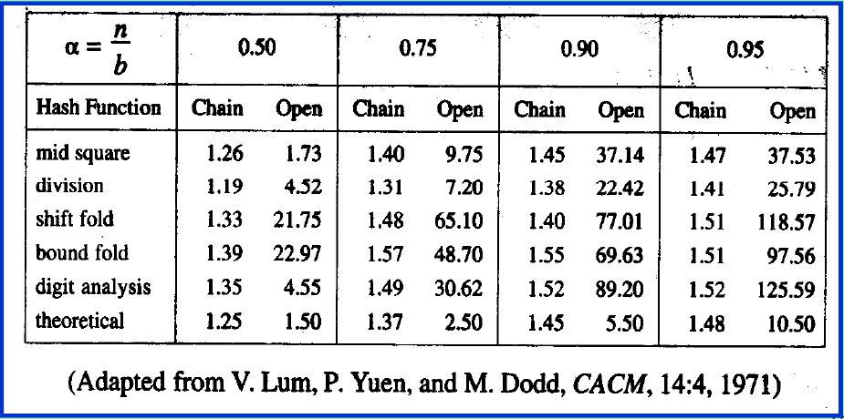
A Comparison
Hash Function
Division is generally superior to the other types
Collision handling
Chaining outperforms linear open addressing

Slide 64
Chaining vs. Open Addressing
Chaining | Open Addressing
Elements can be stored at outside of the table | In open addressing elements should be stored inside the table only
In chaining at any time the number of elements in the hash table may be greater than the size of the hash table | In open addressing the number of elements present in the hash table will not exceed to number of indices in hash table.
In case of deletion chaining is the best method | If deletion is not required. Only inserting and searching is required open addressing is better
Chaining requires more space | Open addressing requires less space than chaining.

Slide 65
Outline
8.1 Introduction
8.2 Static hashing
8.3 Dynamic hashing
8.4 Bloom filters

Slide 66
8.3 Dynamic Hashing
In static hashing, if the hash table is allocated to be too small, then when the data exceeds the capacity of the hash table (loading density exceeds a threshold), the entire table must be extended (size increased) and restructured:
e.g., b buckets, divisor D = b → 2b + 1 buckets, and new D = 2b+1 ⇒ hash function changed ⇒ the whole hash table needs rebuilt all over (not copy) -- a time-consuming process.
For very large dictionary being accessed 24/7, that means unacceptable interruption of service during hash table rebuilding.

Slide 67
Hash Table Size: b → 2b+1
hashed key h_{D}(k) = bucket index
h_{D}(k) = [0,…, b-1], D = b
(k1,e1)
(k2,e2)
(k1,e1) | (k2,e2)
k
h_{D}(k)
b
k
h_{D’}(k)
2b+1
D = b → D’ = 2b+1
Hash table needs rebuilt all over again (not simple copy)

Slide 68
Dynamic Hashing
Dynamic hashing, or extendible hashing:
Aims to reduce rebuild time by ensuring that each rebuild changes the home bucket for the entries in only one bucket, so that it can provide acceptable hash table performance on a per operation basis
Retain the fast retrieval time while extending -- dynamically increasing and decreasing table size with very little penalty.
Two forms of Dynamic hashing
Dynamic hashing using directory
Directoryless dynamic hashing

Slide 69
Dynamic Hashing Using Directory
Assume a file F is a collection of records R.
Each record has a key field K
Records are stored in pages or buckets whose capacity is 2^{p}
Dynamic hashing using directory first map key k to directory d by using h(k,p), p LSbits of h(k), which contains pointers to 2^{p} buckets
When overflow, increase p, thus the size of directory is increased, and dynamically add new buckets with minimal bucket restructuring.
With directory in memory and records in disk, it is aimed to minimize access to pages

Slide 70
Dynamic Hashing Using Directory
hashed key h(k) = sufficiently large
h(k,p) = p LSb bits from h(k) → Directory d → pointer to bucket
Directory can double when overflow occurs
h(k) =
(k1,e1) | (k2,e2)
(k3,e3)
xxxx xxxx xxxx xxxx
k
h(k)
h(k, p)
Directory d
Hash table dynamically add new buckets

Slide 71
Dynamic Hashing Using Directories
Given a partial list of identifiers (key) in the following:
k | h(k)
A0 | 100 000
A1 | 100 001
B0 | 101 000
B1 | 101 001
C1 | 110 001
C2 | 110 010
C3 | 110 011
C5 | 110 101
A → 100
B → 101
C → 110
..
0 → 000
1 → 001
2 → 010
3 → 011
4 → 100
..
h(k) 6 bits
Take p LSb bits
→ directory size = 2^{p}
→ directory depth = p

Slide 72
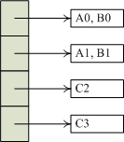
Starting with p = 2, 6 pairs in Buckets
Assume dictionary already contains 6 keys A0, A1, B0, B1, C2, C3 → p = 2 = directory depth as shown below:
h(k,2)
00
A0 → 00
B0 → 00
A1 → 01
B1 → 01
C2 → 10
C3 → 11
01
10
11
Insert C5 into dictionary: h(C5,2) = 01 → overflow

Slide 73
When Overflow
Insert C5,h(C5,2) = 01 – bucket 01 overflows
Find a least u such that the values of h(k,u) of new insert key and keys in overflowed bucket are not the same → u = 3 in this case
Double the size of directory. Copy the original pointers in the upper half into the new lower half
Restructure by splitting only the home (overflow) bucket:
h(A1,3) = 001, h(B1,3) = 001, remain at the same old bucket
h(C5, 3) = 101, only C5 → add a new bucket 101 for C5

Slide 74
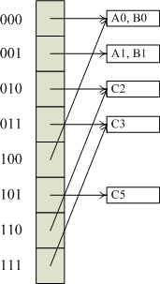
If insert C1 into dictionary: h(C1,3) = 001 → overflow

Slide 75
When Overflow
Insert C1,h(C1,3) = 001 – bucket 001 overflows
Find a least u such that the values of h(k,u) of new insert key and keys in overflowed bucket are not the same → u = 4 in this case
Double the size of directory. Copy the original pointers in the upper half into the new lower half
Restructure by splitting only the home (overflow) bucket:
h(A1,4) = 0001, h(B1,4) = 1001, h(C1, 4) = 0001
h(B1, 4) = 1001, → add a new bucket 1001 for B1, insert C1 to Bucket 0001

Slide 76
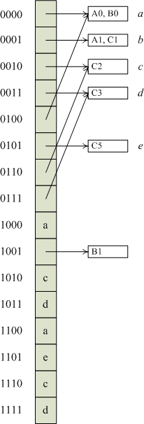
Following the doubling of directory, split the overflow bucket bucket 0001 by h(k,4)
A1, C1 → bucket 0001
B1 → bucket 1001 – new bucket
Add new bucket and move B1 here

Slide 77
Dynamic Hashing Using Directory
Deletion from a dynamic hash table with a directory is similar to insertion.
Although dynamic hashing employs array doubling, the time for this array doubling is considerably less than that for the array doubling used in static hashing.
This is because in dynamic hashing, we need to rehash only the entries in the overflow bucket rather than all entries in the table.
Further, savings result when the directory resides in memory while the buckets are on disk.
A search requires only 1 disk access; an insert makes 1 read and 2write access to the disk; the array doubling requires no disk access.

Slide 78
Directoryless Dynamic Hashing
Dispense with the directory, d, of bucket pointers.
An array, ht, of buckets is used.
Assume that this array is as large as possible and there is no possibility of increasing its size dynamically.
To avoid initializing such a large array, use two variables q and r, 0 ≤ q < 2^{r}, to keep track of the active buckets.
At any time, only buckets [0, 2^{r} + q -1] are active. New active buckets can be added when needed by changing q and/or r (q++; → if q = 2^{r} → q=0, r++;)
Each active bucket is the start of a chain of bucket. The remaining buckets on a chain are called overflow buckets.

Slide 79
Index Rules for Active Buckets
The active buckets 0 through q-1 as well as the active buckets 2^{r} through 2^{r} + q -1 are indexed using h(k,r+1)
While the remaining active buckets q through 2^{r} -1 are indexed using h(k,r)
Each active bucket is the start of a chain of bucket. The remaining buckets on a chain are called overflow buckets.
h(k,r+1)
h(k,r+1)
ht
0
q
2^{r}
2^{r}+q
Overflow buckets
h(k,r)
Active buckets

Slide 80
Searching Directoryless Hash Table
To search for key k, we need to compute h(k,r)
Program 8.6: Searching a directoryless hash table
If ( h(k,r) < q )
search the chain that begins at bucket h(k, r+1);
else
search the chain that begins at bucket h(k,r);

Slide 81
Overflow Handling
To insert new key-element, search to determine if the key is already in ht.
When search is done, new key is not in ht, and the active bucket for the searched chain is full, we get an overflow.
An overflow is handled by
Activating bucket 2^{r} + q (add a new active bucket)
Reallocate (rehashing) the entries in the chain q between q and the newly activated bucket (or chain) 2^{r} + q using h(k,r+1).
q = q + 1; if (q == 2^{r}) {q=0; r=r+1;}
Finally, the new key-element is inserted into the chain where it would be searched for by search algorithm using the new r and q values.
If h(k,r)<q use h(k,r+1) else use h(k,r)

Slide 82

To start, assume there are 4 (2^{r}+q) bucket chains (r=2,q=0); each chain begins at one of the 4 active buckets and comprises only that active bucket (i.e., there are no overflow buckets). Each bucket has 2 slots.
To Insert k = C5, first determine if C5 is in ht by using search algorithm. If not, check if overflow.
(a) r = 2, q = 0
Search C5: h(C5,2) = 01 ⇒ h(C5,2) > q (= 0), use h(C5,2) = 01 and search that chain,
C5 not found, check if the active bucket for the searched chain is full
Yes ⇒ overflow ⇒ Handle overflow
Active buckets = 2^{r}+q=4
k | h(k)
A0 | 100 000
A1 | 100 001
B0 | 101 000
B1 | 101 001
C1 | 110 001
C2 | 110 010
C3 | 110 011
C5 | 110 101

Slide 83
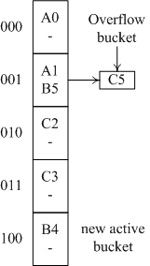
Insert k = C5, to search k = C5, first compute h(k,r)
h(C5,2) = 01 > q (0) ⇒ examine bucket 01 using h(k,r) ⇒ C5 not found and bucket full ⇒ overflow
(a) r = 2, q = 0, Insert C5
(b) Insert C5, r = 2, q = 1
Overflow handling
Activate bucket 2^{r} + q = 100
Reallocating A0,B4 in the chain q (i.e., chain 0) using h(k,r+1):
h(A0,r+1) = 000, h(B4,r+1) = 100, ⇒ A0 not moved,
B4→bucket 100
q = q+1 =1, r = 2 unchanged
Insert C5: h(C5,r)=01 ⇒ use h(C5,2)=01, C5 added to bucket 01 using overflow bucket
h(k,r)
h(k,r+1)

Slide 84
Insert k = C1, to search k = C1, first compute h(k,r)
h(C1,2) = 01 = q (1) ⇒ examine bucket 01 using h(k,r) ⇒ C1 not found and bucket full ⇒ overflow
(b) r = 2, q = 1
Overflow handling
Activate bucket 2^{r} + q = 101
Reallocating (rehashing) A1,B5,C5 in the chain q (i.e., chain 1) using h(k,r+1):
h(A1,r+1) = 001, h(B5,r+1) = 101,
h(C5,r+1) = 101
⇒ A1 not moved,
B5,C5→bucket 101
q = q+1 =2 < 2^{r}, r = 2 unchanged
Insert C1: h(C1,r)=01<q=2 ⇒ C1 added to bucket h(C1,r+1)=001
h(k,r)
h(k,r+1)

Slide 85
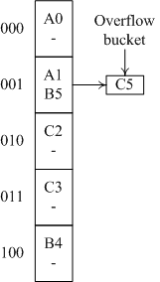
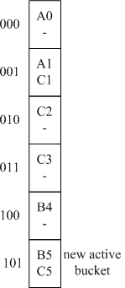
(b) r = 2, q = 1, Insert C1
(c) r = 2, q = 2
Chain q relocated using h(k,r+1)
h(k,r)
h(k,r+1)
h(k,r+1)
h(k,r)

Slide 86
Outline
8.1 Introduction
8.2 Static hashing
8.3 Dynamic hashing
8.4 Bloom filters

Slide 87
Bloom Filter Concepts
Proposed by Burton Howard Bloom in 1970
A Bloom filter is a data structure designed to tell you, rapidly and memory-efficiently, whether an element is present in a set.
It is a probabilistic data structure that uses the concept of hashing extensively.
The price paid for this efficiency is that a Bloom filter is a probabilistic data structure: it tells us that the element either definitely is not in the set (no false negative) or may be in the set (may have false positive).

Slide 88
Bloom Filter Concepts
Consider matching two strings in checking for passwords from a database.
The passwords are encrypted and then stored in the database for security reasons. The hashed values are very long strings, usually 70+ characters.
In such cases, when two strings need to be compared character by character, string matching algorithms take O(n).
Bloom filter, on the other hand, takes O(1) to accomplish the same task.
What is the additional advantage of using a bloom filter?
Bloom filters reduce the number of calls made to resources such as servers and databases, by quickly eliminating inputs that don’t match with the actual value.

Slide 89
Bloom Filter Concepts
 | Traditional set data structures, e.g., a BST | Bloom filters
False positive (It could be wrong when it says "Yes") | X | √ (缺點)
False negative (It could be wrong when it says "No") | X | X
Easy insertion | √ | √
Easy deletion | √ | X (缺點)
Memory space efficiency | Low | High (優點)

Slide 90
Applications of Bloom Filter
Authentication:
Bloom filters can check for passwords and reject all of the wrong passwords entered, thus reducing the load on the main database servers.
Authorization:
Authorization is the process of giving access to users of a website based on the level of authority a user possesses.
The admin can access the entire website and make changes, whereas a common user can view the website in read-only mode. Therefore using bloom filters in websites like large e-commerce sites is a viable solution to prevent access from non-authorized entries.

Slide 91
Applications of Bloom Filter
One-search (one-hit) wonders:
Search engines keep track of the search phrases and ensure not to cache the phrases until they are searched for repetitively.
We can do a little experiment to check this out.
Open your incognito tab and go to any search engine you’d like. Type a query related to Python, for example, “lists in python”. The next time you type lists, it will still show results that are not specific to Python.
A couple of searches related to Python will lead to all search results being directed towards Python.
After a couple of searches, you will observe that just typing dictionary will lead you to dictionaries in Python.
Search engines keep track of the URLs and enable caching of the URLs upon multiple accesses.

Slide 92
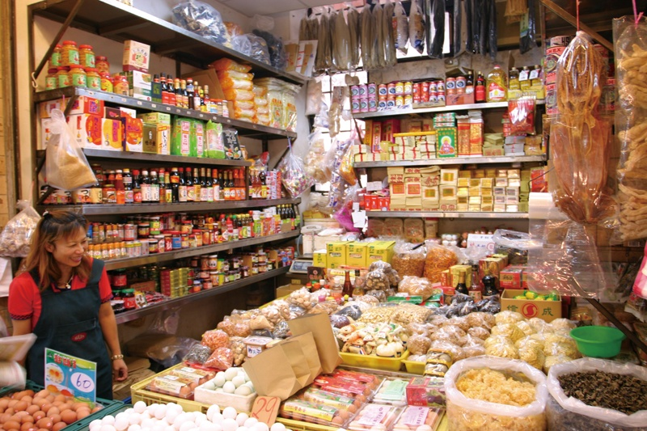
Grocery Shop Example
Suppose we own a grocery shop
Customers occasionally ask for an item that we are not sure about the availability
We spend significant time looking for an item before realizing that the item is unavailable
This significant time can be spared if we know that the item is definitely not available.

Slide 93

Grocery Shop Example
Bloom filter can help
Determine the availability of an requested item
Some false positive are acceptable
i.e., the data structure tells that an item is available, but the fact is otherwise
No false negative
We do not want to mistakenly turn down a customer‘s request

Slide 94
Bloom Filter
Bloom filter is an exciting application of the hash tables used to check for membership of elements in a set
Components of bloom filter
An m-bit vector, initially filled with 0
Multiple (k) hash functions (k < m)
The hash functions used in a Bloom filter should be independent and uniformly distributed.
They should also be as fast as possible (cryptographic hashes such as SHA1, though widely used therefore are not very good choices).
And n elements in the set
False positive rate will be approximately (1-e^{-kn/m})^{k}

Slide 95
Bloom Filter
Example
A table with 26 entries, A ~ Z, initially 0
Three hash functions for a string
First character
Second character
Third character
A
N
B
O
C
P
D
Q
E
R
F
S
G
T
H
U
I
V
J
W
K
X
L
Y
M
Z

Slide 96


Bloom Filter
Available items
Example
Register string "Coke" into the Bloom filter to indicate that our grocery sells Coke
Set the bit vector according to the three hash values, C, O, and K
A
1
1
N
1
B
O
C
P
D
Q
E
R
F
S
G
T
"Coke"
"C"
H
U
h₁
I
V
h₂
"O"
J
W
K
X
h₃
"K"
L
Y
M
Z

Slide 97


Bloom Filter
Available items
A simple test
If a customer request for "Coke" afterward
Bit vector is examined according to the three hash values
Bloom filter determines that coke is available because the corresponding bits have been set
A
1
1
N
1
B
O
C
P
D
Q
E
R
F
S
"Coke"
G
T
h₁
"C"
H
U
h₂
"O"
I
V
J
W
h₃
"K"
K
X
L
Y
M
Z

Slide 98
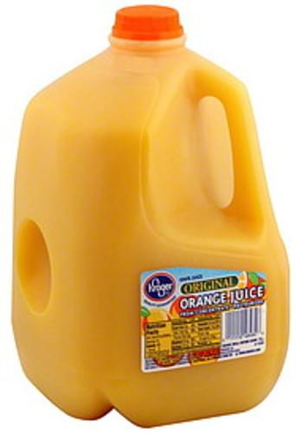

Bloom Filter
Available items
A simple test
If a customer request for “Orange juice" afterward
Bloom filter determines that Orange juice is unavailable because at least one corresponding bit is not set
A
1
1
N
1
B
O
C
P
D
Q
E
R
F
S
" Orange juice "
h₁
“O"
G
T
H
U
h₂
“R"
I
V
J
W
h₃
"A"
X
K
L
Y
M
Z

Slide 99

Bloom Filter
Available items
A simple test
If a customer request for “Tea" afterward
Bloom filter determines that Tea is unavailable because at least one corresponding bit is not set
A
1
1
N
1
B
O
C
P
D
Q
E
R
F
S
"Tea"
h₁
"T"
G
T
H
U
h₂
"E"
I
V
J
W
h₃
"A"
X
K
L
Y
M
Z

Slide 100
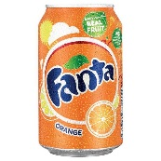


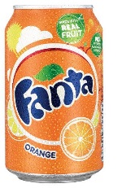

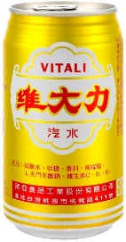
Bloom Filter
Available items
We register more strings into the Bloom filter (add more elements to set) (The bit vector gets filled up)
A
1
1
1
1
1
N
1
1
1
1
1
1
1
B
O
C
P
D
Q
"Fanta" → F A N
E
R
F
S
"Sprite" → S P R
G
T
H
U
I
V
J
W
"Vitali" → V I T
K
X
L
Y
M
Z

Slide 101


Bloom Filter
Available items
Test again
Bloom filter still works
A
1
1
1
1
1
N
1
1
1
1
1
1
1
B
O
C
P
D
Q
"Coke" → C O K
E
R
F
S
G
T
"Tea" → T E A
H
U
I
V
J
W
"Fanta" → F A N
K
X
L
Y
M
Z

Slide 102
Advantages
Simple & fast & memory efficient
Bloom filters filter out the majority of true negatives and therefore enable the design of efficient systems.
A
1
1
1
1
1
N
1
1
1
1
1
1
1
B
O
C
P
D
Q
E
R
"Coca Cola
"Fanta"
"Sprite"
"Vitali
F
S
G
T
H
U
I
V
Only 26 bits
J
W
…
K
X
L
Y
M
Z

Slide 103

Disadvantages
Available items
Bloom filter exhibits false positive
When Bloom filter says "yes", it is not 100% true
But, when Bloom filter says "no", it is always true
"Coffee" is a false positive in our example (so is “Orange juice”)
A
1
1
1
1
1
N
1
1
1
1
1
1
1
B
O
C
P
D
Q
E
R
F
S
G
T
"Coffee" → C O F
H
U
I
V
Our grocery does not sell coffee actually!
J
W
K
X
L
Y
The probability of error goes up as the bit array gets filled up.
M
Z

Slide 104
Bloom Filter Analysis
Key factors of a bloom filter
Number of hash functions, k
Number of bits in the bit vector, m
Number of items expected to be stored, n
Uniformity of the hash functions
False positive analysis
Bit vector is set nk times after n items are stored
Each time, the probability that a particular bit is set is (1/m)
Assume true uniformity of hash functions ((1-1/m) → not set)
The probability that a particular bit is set after n items are stored is (1 - (1 - 1/m)^{nk})
The probability of a false positive is (1 - (1 - 1/m)^{nk})^{k}
We can carefully select m, n, and k to achieve our acceptable false positive rate, e.g., 1%

Slide 105




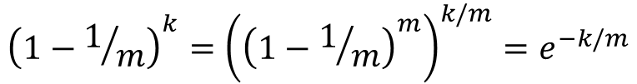
Note:
$${\lim_{m→∞}\left(1−1/m\right)}^{m}=e^{−1}$$
For large m
$${\left(1−1/m\right)}^{m}≈e^{−1}$$
$${\left(1−1/m\right)}^{k}={\left({\left(1−1/m\right)}^{m}\right)}^{k/m}=e^{−k/m}$$
$${\left(1−1/m\right)}^{nk}=e^{−nk/m}$$
So:
$${\left({1−\left(1−1/m\right)}^{nk}\right)}^{k}={\left({1−e}^{−nk/m}\right)}^{k}$$

Slide 106
Hash Functions
The hash functions used in a Bloom filter should be independent and uniformly distributed. They should also be as fast as possible (cryptographic hashes such as SHA1, though widely used therefore are not very good choices).
A short survey of bloom filter implementations:
Chromium uses HashMix
python-bloomfilter uses cryptographic hashes
Plan9 uses a simple hash as proposed in Mitzenmacher 2005
Sdroege Bloom filter uses fnv1a
Squid uses MD5

Slide 107
How Big Should Bloom Filter Be?
It's a nice property of Bloom filters that you can modify the false positive rate of your filter. A larger filter will have less false positives, and a smaller one more.
Your false positive rate will be approximately
(1-e^{-kn/m})^{k}, so you can just plug the number n of elements you expect to insert, and try various values of k and m to configure your filter for your application

Slide 108
How Many Hash Functions?
The more hash functions you have, the slower your bloom filter, and the quicker it fills up. If you have too few, however, you may suffer too many false positives.
Since you have to pick k when you create the filter, you'll have to ballpark what range you expect n to be in. Once you have that, you still have to choose a potential m (the number of bits) and k (the number of hash functions).
It seems a difficult optimization problem, but fortunately, given an m and an n, we have a function to choose the optimal value of k: (m/n)ln(2)

Slide 109
Determine A Bloom Filter’s Size
To choose the size of a bloom filter
Choose a ballpark value for n
Choose a value for m
Calculate the optimal value of k
Calculate the error rate for our chosen values of n, m, and k. If it's unacceptable, return to step 2 and change m; otherwise we're done.

